Slide 1
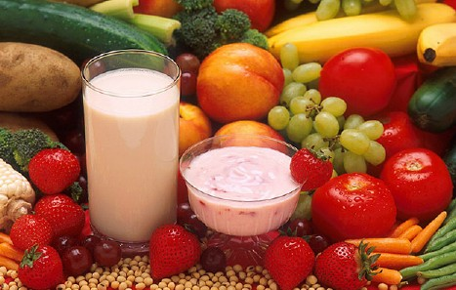
Ideas for Better Snacking
Danielle Miller
Morrison-Chartwells Dietetic Intern

Slide 2
Topics
Snack Basics
When to snack
Building A Healthy Snack
Portion Sizes
Snack on the go
Dip It!
Snack Ideas

Slide 3
Snack Basics
Available:
  have a snack already prepared after school or put healthy snacks in front of the refrigerator/cupboard/counter
Tasty and visually appealing:
  include food you know your kids will eat and present it in a fun and attractive way
Portable:
  have healthy snacks pre-packaged in baggies or cut up in small containers for cars or backpacks
Fun:
  change things up and be creative!

Slide 4
When to Snack
Purpose of snack
  Refuel between meals
At least 1 ½ hours before meal
Snacking not Grazing all day
Before after school activities
Between meals

Slide 5
Building a Healthy Snack
Choosing from 2 Food Group
  Grain, Dairy, Fruit, Vegetables, Meat/Nuts
    Fruit and Yogurt
    Cheese sandwich
    Carrots and peanut butter
Choosing low fat food items
Choose whole grains
Encourage drinking water
Choose 100% fruit juice

Slide 6
Dip It!
• Dip pretzels in mustard.
• Dip pita chips in hummus.
• Dip graham crackers in applesauce.
• Dip baked tortilla chips in bean dip.
• Dip animal crackers in low-fat pudding.
• Dip bread sticks in salsa.
• Dip mini-toaster waffles in cinnamon applesauce.

Slide 7
Snack Ideas
Snack Ideas your kids can be involved with
  Trail Mix
  Fruit and Cheese Kabobs
  Yogurt Parfait
  Ants on a Log
  Veggie Pizza

Slide 8
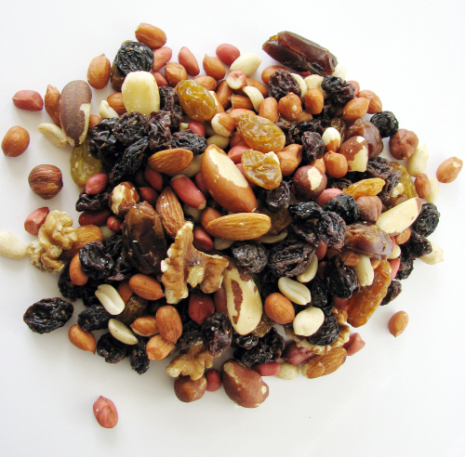
Snack Idea
Make your own train mix
  Add peanuts, raisins, chocolate chips, mini pretzels, dry cereal, granola or dried fruit

Slide 9
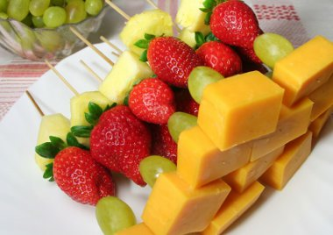
Snack Ideas
Fruit and Cheese Kabobs
  Put low fat cheese squares and fruit pieces on toothpicks

Slide 10
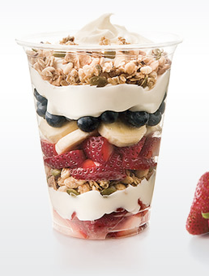
Snack Ideas
Fruit Parfait
  Layer vanilla yogurt and banana or blueberries (or any fruit) in a tall glass. Top with a sprinkle of granola.

Slide 11
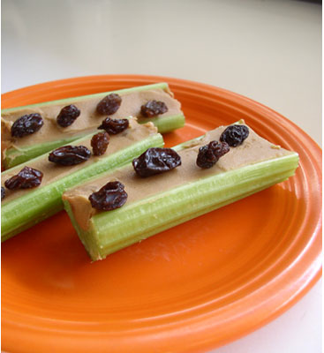
Snack Ideas
Ant on a Log
  Celery with peanut butter and raisins on top

Slide 12
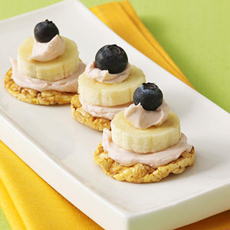
Snack Ideas
Blueberry Banana Stacks
  Mini popcorn cakes topped with low fat cream cheese, banana, cream cheese and a blueberry

Slide 13
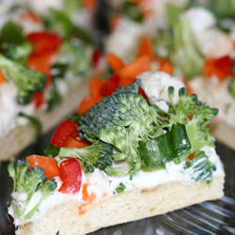
Snack Ideas
Veggie Pizza
  Whole grain crust covered in low fat cream cheese and topped with chopped veggie

